Slide 1
Structure Functions in SQG Turbulence: Preliminary simulations
28th May 2021

Slide 2
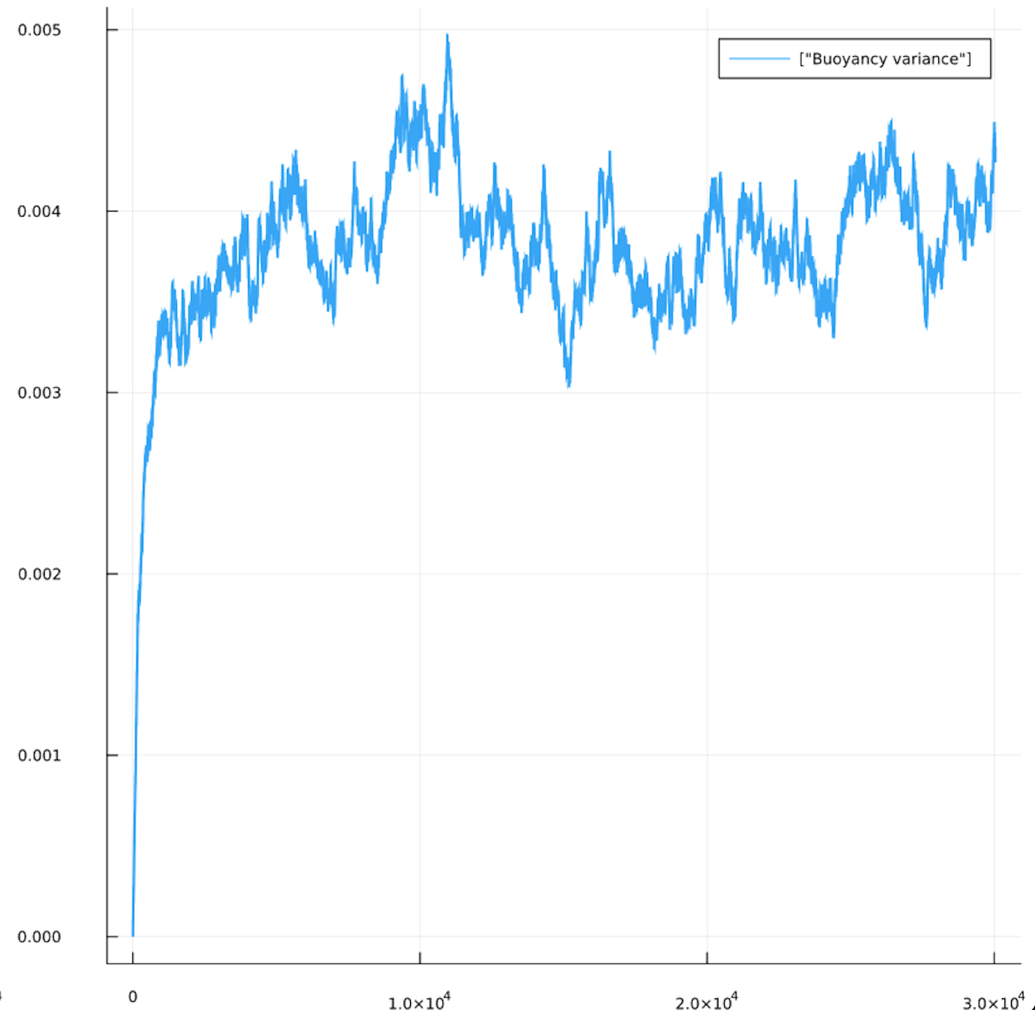
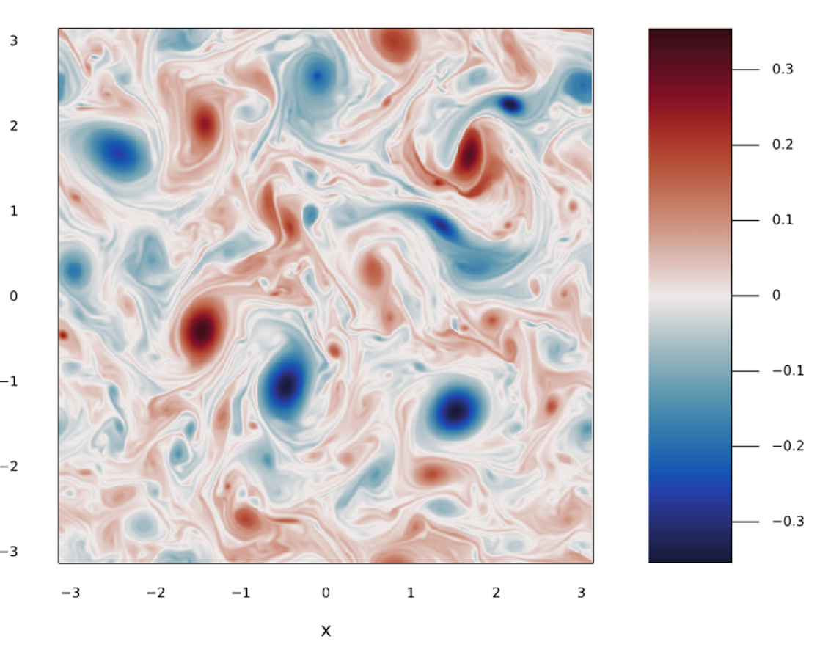
Isotropic SQG: Simulation
512 x 512, 2*pi domain width, buoyancy variance forced at k=7
Buoyancy Field
Buoyancy variance
Start point for calculations, 52 snapshots
Time

Slide 3
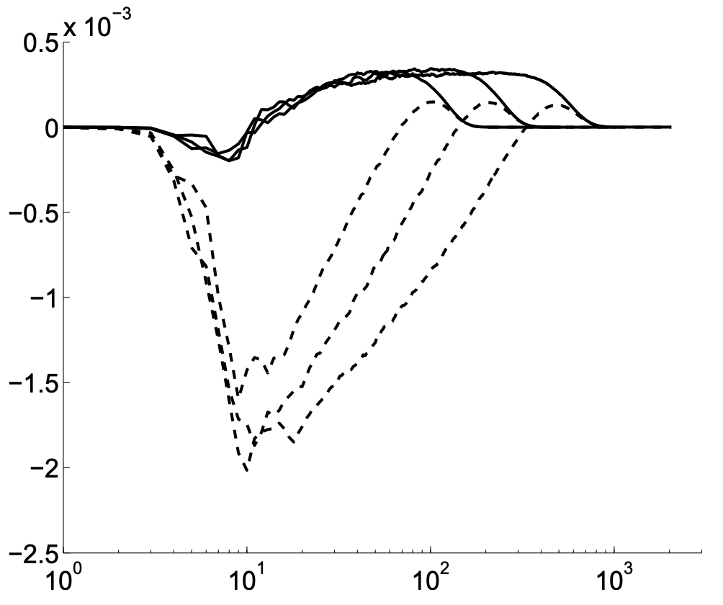
Isotropic SQG: Spectral Fluxes
512 x 512, 2*pi domain width, buoyancy variance forced at k=7
b’b’ Dissipation rate (small-scale)
Drag rate (large-scale)
Capet (2008) fluxes
Time

Slide 4
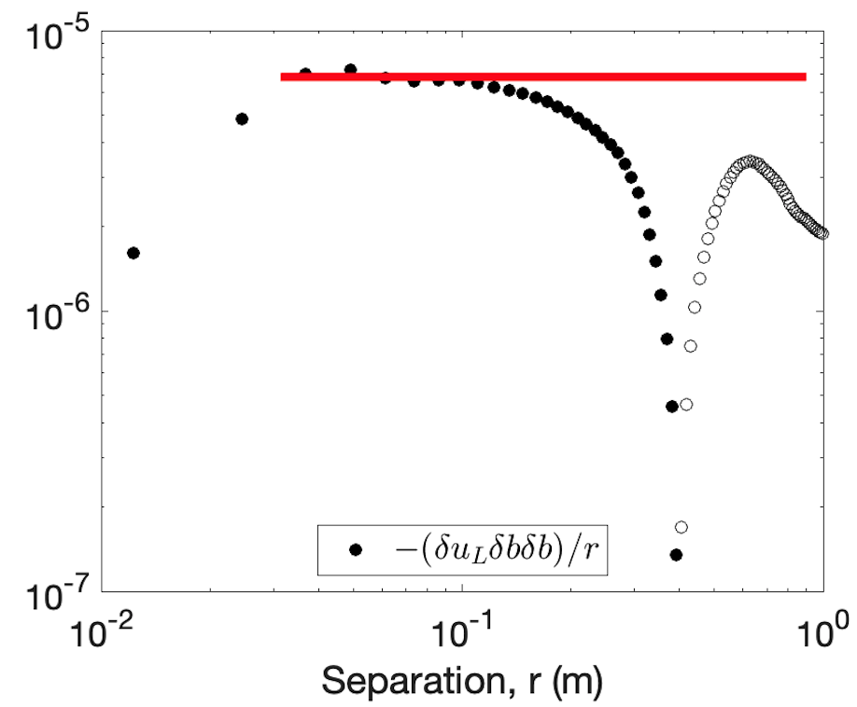
Isotropic SQG: Structure Functions
512 x 512, 2*pi domain width, buoyancy variance forced at k=7
b’b’Dissipation rate
Advective (buoyancy)
Third-order (buoyancy)
Dissipation rate (large-scale)

Slide 5
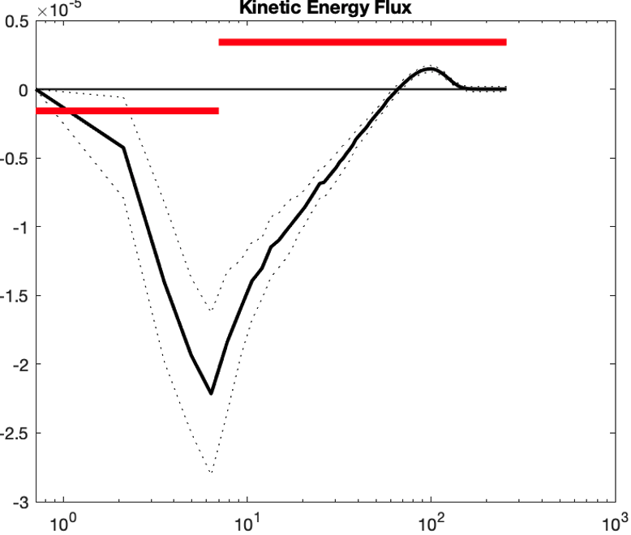
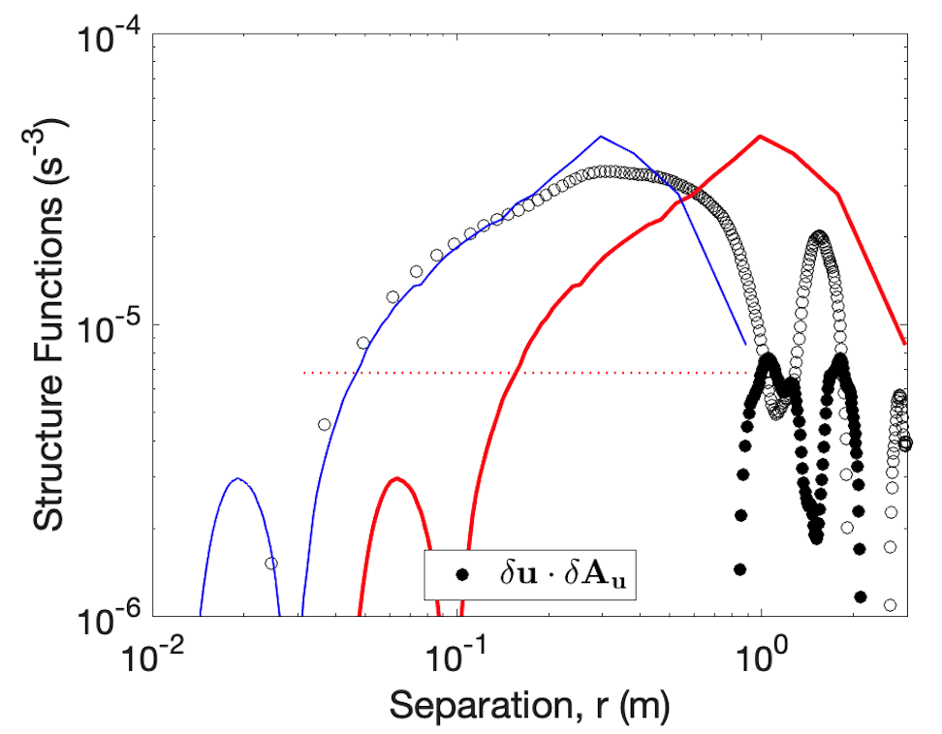
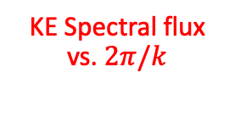
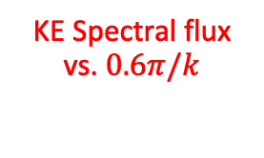
Isotropic SQG: Structure Functions
Advective (velocity)
KE Spectral flux vs. $2π/k$
KE Spectral flux vs. $0.6π/k$
Third-order (long. velocity)

Slide 6
Anisotropic SQG: Simulation
512 x 512, 2*pi domain width, buoyancy variance forced at k=7
Buoyancy Field
Buoyancy variance
Start point for calculations, 52 snapshots
Time

Slide 7
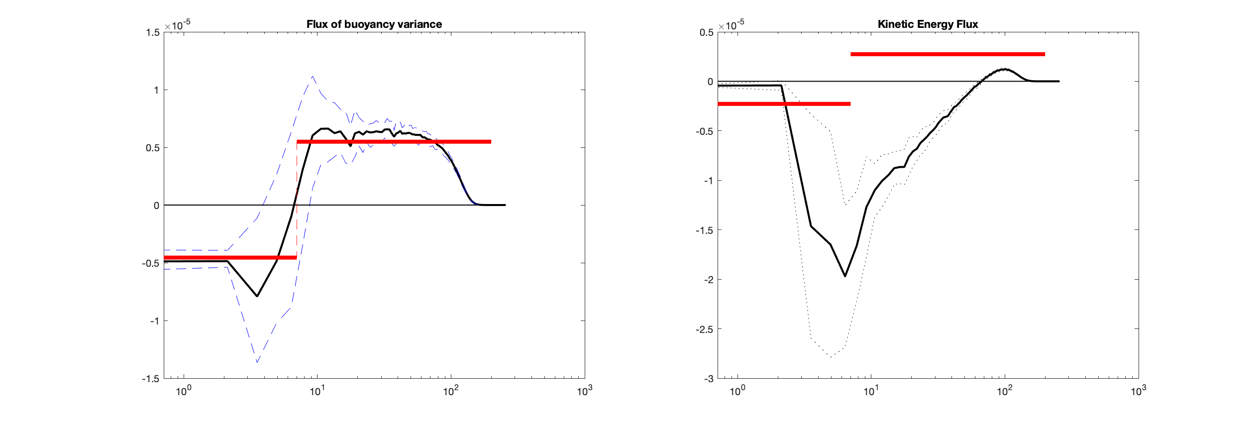
Anisotropic SQG: Spectral Fluxes
512 x 512, 2*pi domain width, buoyancy variance forced at k=7
b’b’ Dissipation rate (small-scale)
Drag rate (large-scale)
Capet (2008) fluxes
Time

Slide 8
Isotropic SQG: Structure Functions
512 x 512, 2*pi domain width, buoyancy variance forced at k=7
b’b’Dissipation rate
Advective (buoyancy)
Third-order (buoyancy)
Dissipation rate (large-scale)

Slide 9
Isotropic SQG: Structure Functions
512 x 512, 2*pi domain width, buoyancy variance forced at k=7
b’b’Dissipation rate
Advective (buoyancy)
Third-order (buoyancy)
Dissipation rate (large-scale)

Slide 10
Isotropic SQG: Structure Functions
Advective (velocity)
KE Spectral flux vs. $2π/k$
Third-order (long. velocity)
KE Spectral flux vs. $0.6π/k$

